Slide 1

ATAX Problem Optimization
Assignment 2 – Team 4
Davide Buchignani – Francesco Caligiuri - Luca Di Leo

Slide 2
ATAX
The process of ATAX involves the multiplication of the matrix A, its transpose, and the vector x. This operation is fundamental in linear algebra for various computational tasks.
y = A^{T} A x

Slide 3
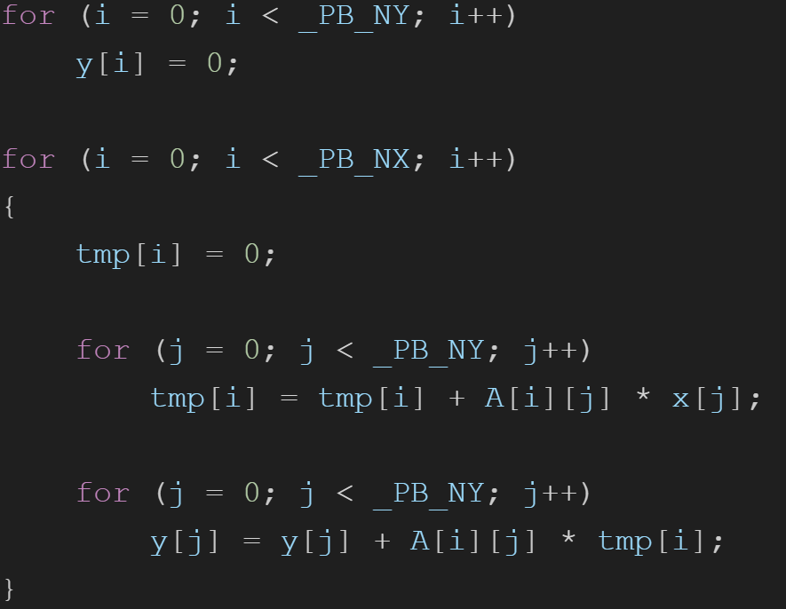
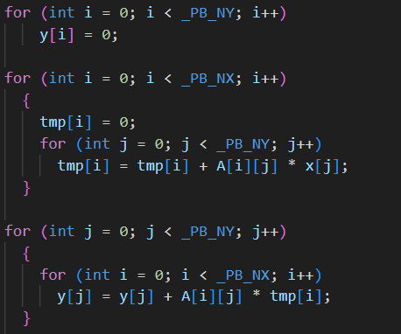
Code
Initialization of solution vector y
Computation of tmp = A ⋅ x
Computation of y = A^{T} ⋅ tmp

Slide 4
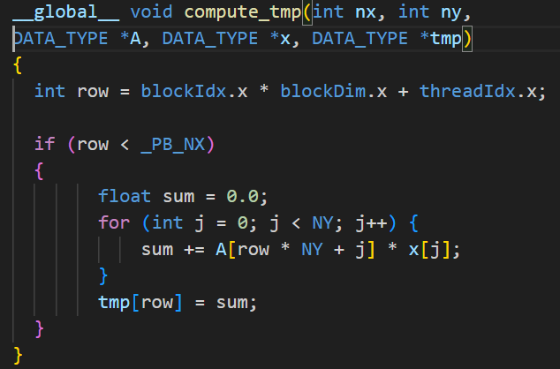
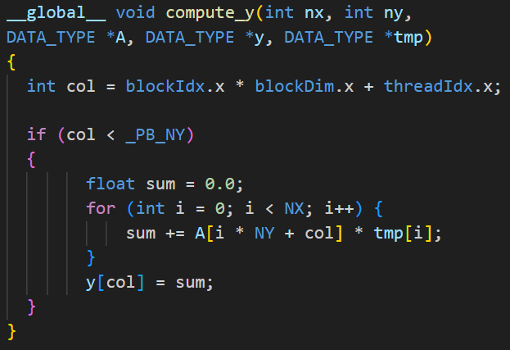
Our Kernels:
Plus another version using the shared memory for the vector x and tmp

Slide 5
RESULTS COMPARISON imagine time execution di sequenziale opt1 e opt2

Slide 6
Immagine del profiling di opt1, ossia quanto tempo impiega:
Kernels
Memoria
sincronizzazione

Slide 7
Immagine del profiling di opt2, ossia quanto tempo impiega:
Kernels
Memoria
sincronizzazione

Slide 8
ACHIEVED SPEEDUP

Slide 9
Conclusions
Conclusione 1
Conclusione 2

